Slide 1



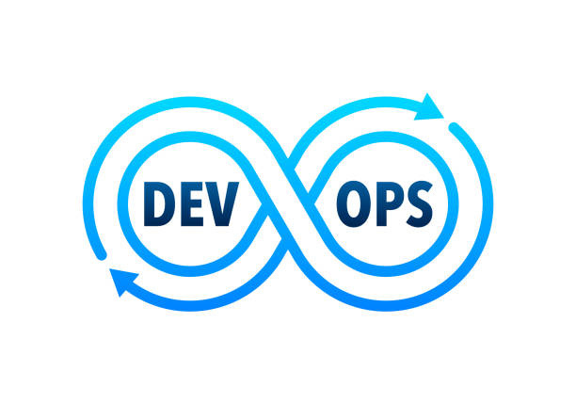
DEVOPS PIPLINE PROJECT 2025
TEAM MEMBERS:
YAT340N_ONL2_SWD1_G1
Group 2

Slide 2
REQUIREMENTS GATHERING
STAKEHOLDER ANALYSIS:
Project Sponsor: Defines high-level project objectives and provides funding.
Lecturer/Supervisor: Evaluates project progress and provides feedback.
Developers (YOU/TEAM MEMBERS): IMPLEMENT AND MAINTAIN THE CI/CD PIPELINE.
END USERS (DEVS & OPS TEAMS): USE THE AUTOMATED PIPELINE FOR EFFICIENT DEPLOYMENTS.
SYSTEM ADMINISTRATORS: ENSURE THE INFRASTRUCTURE SUPPORTS THE DEPLOYMENT.
SECURITY TEAM: ENFORCES SECURITY POLICIES WITHIN THE CI/CD PIPELINE.
CLOUD PROVIDERS (AWS, GCP, ETC.): PROVIDE HOSTING AND INFRASTRUCTURE FOR DEPLOYMENT.

Slide 3
REQUIREMENTS GATHERING
USER STORIES & USE CASES
USEr Stories:
As a developer, I want to push my code to GitHub so that the pipeline aUTOMATICALLY BUILDS AND TESTS MY APPLICATION.
AS AN OPERATIONS ENGINEER, I WANT THE SYSTEM TO DEPLOY APPLICATIONS SEAMLESSLY SO THAT DOWNTIME IS MINIMIZED.
AS A SECURITY OFFICER, I WANT THE CI/CD PIPELINE TO ENFORCE SECURITY POLICIES SO THAT ONLY VERIFIED CODE IS DEPLOYED.

Slide 4
REQUIREMENTS GATHERING
USE CASES:
CODE Commit & Build Trigger – A developer pushes code, triggering an aUTOMATED BUILD IN JENKINS.
AUTOMATED TESTING – JENKINS RUNS UNIT TESTS BEFORE PROCEEDING TO DEPLOYMENT.
CONTAINERIZATION & DEPLOYMENT – DOCKER CONTAINERS ARE BUILT AND DEPLOYED TO A CLOUD SERVER.
MONITORING & NOTIFICATIONS – THE PIPELINE SENDS ALERTS IN CASE OF BUILD FAILURES OR SECURITY ISSUES.

Slide 5
REQUIREMENTS GATHERING
FUNCTIONAL REQUIREMENTS:
CI/CD PIPELINE: Automates build, test, and deployment processes.
Source Code Integration: Connects with GitHub for aUTOMATIC TRIGGERS.
AUTOMATED TESTING: RUNS UNIT TESTS TO VALIDATE CODE CHANGES.
CONTAINERIZATION: USES DOCKER TO PACKAGE APPLICATIONS.
DEPLOYMENT AUTOMATION: USES ANSIBLE/KUBERNETES FOR AUTOMATED CLOUD DEPLOYMENT.
NOTIFICATIONS: SENDS ALERTS SLACK FOR PIPELINE UPDATES.

Slide 6
REQUIREMENTS GATHERING
NON-FUNCTIONAL REQUIREMENTS :
PERFORMANCE: THE PIPELINE should complete a build and deployment in under 5 minutes.
Security: Implement role-based access control (RBAC) and enforCE IMAGE SCANNING FOR VULNERABILITIES.
USABILITY: PROVIDE CLEAR DOCUMENTATION AND AN INTUITIVE INTERFACE FOR MONITORING THE PIPELINE.
RELIABILITY: ENSURE HIGH AVAILABILITY AND AUTOMATIC FAILURE RECOVERY MECHANISMS.

